Slide 1

OPERATING SYSTEM OVERVIEW

Slide 2
Defination of OS
An Operating System (OS) is an interface between a computer user and computer hardware. An operating system is a software which performs all the basic tasks like file management, memory management, process management, handling input and output, and controlling peripheral devices such as disk drives and printers.
An operating system is software that enables applications to interact with a computer's hardware. The software that contains the core components of the operating system is called the kernel.
An operating system (OS) is system software that manages computer hardware, software resources, and provides common services for computer programs.

Slide 3
Linux Kernel
The main purpose of a computer is to run a predefined sequence of instructions, known as a program. A program under execution is often referred to as a process.
Now, most special purpose computers are meant to run a single process, but in a sophisticated system such a general purpose computer, are intended to run many processes simultaneously. Any kind of process requires hardware resources such as Memory, Processor time, Storage space, etc.
In a General Purpose Computer running many processes simultaneously, we need a middle layer to manage the distribution of the hardware resources of the computer efficiently and fairly among all the various processes running on the computer. This middle layer is referred to as the kernel.

Slide 4
Kernel loads first into memory when an operating system is loaded and remains into memory until operating system is shut down again. It is responsible for various tasks such as disk management, task management, and memory management.
Kernel loads an executable file into memory during ‘exec’ system call’.The major aim of kernel is to manage communication between software i.e. user-level applications and hardware i.e., CPU and disk memory.
Objectives of Kernel :
To establish communication between user level application and hardware.
To decide state of incoming processes.
To control disk management.
To control memory management.
To control task management.

Slide 5
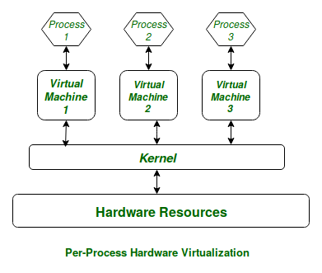

Slide 6
Shell and System Calls
Your interface to the operating system is called a shell. The shell is the outermost layer of the operating system. Shells incorporate a programming language to control processes and files, as well as to start and control other programs.
A Shell provides you with an interface to the Unix system. It gathers input from you and executes programs based on that input. When a program finishes executing, it displays that program's output.
A system call is a way for programs to interact with the operating system. A computer program makes a system call when it makes a request to the operating system's kernel. System call provides the services of the operating system to the user programs via Application Program Interface(API)

Slide 7
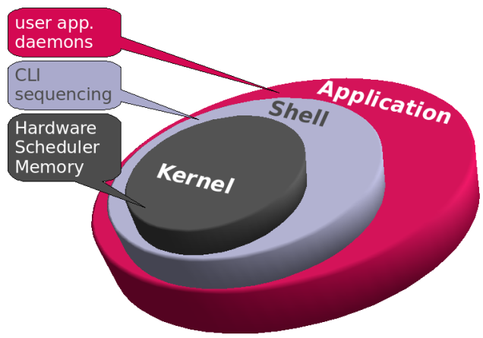
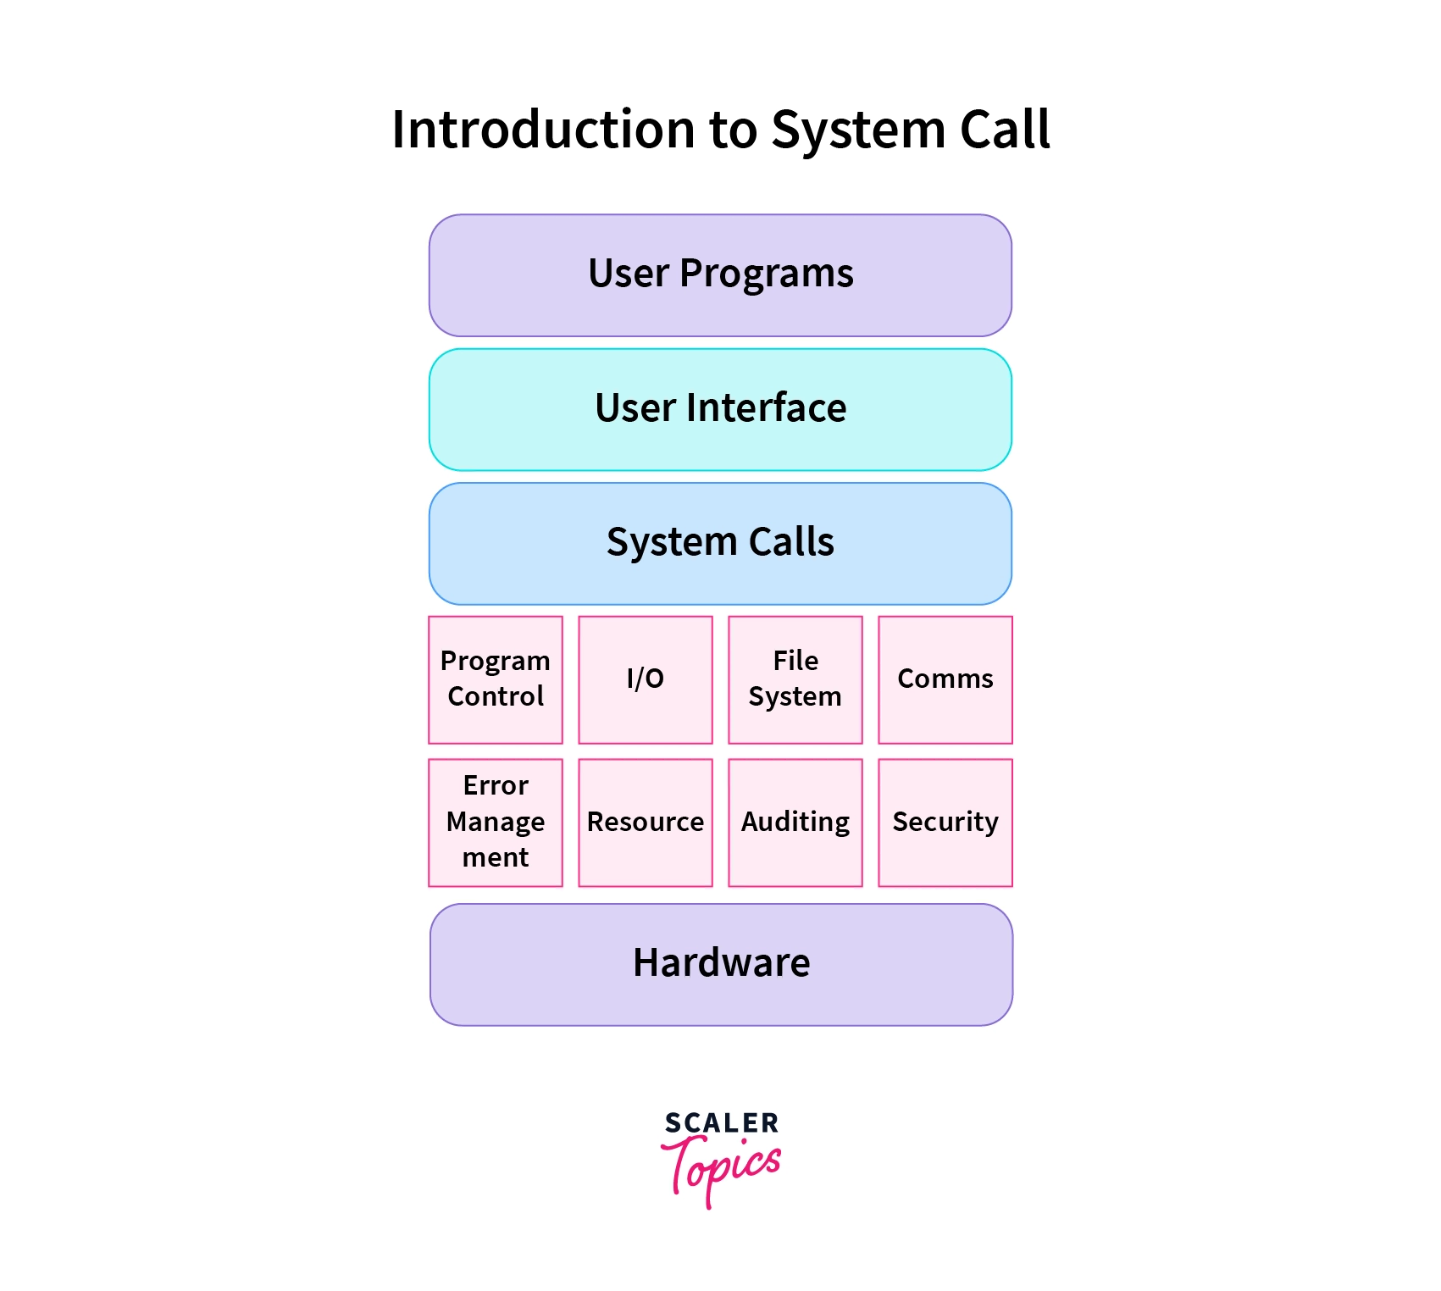

Slide 8
OVERVIEW OF OS
An operating system is a program that manages a computer’s hardware. It also provides a basis for application programs and acts as an intermediary between the computer user and the computer hardware.
An amazing aspect of operating systems is how they vary in accomplishing these tasks. Mainframe operating systems are designed primarily to optimize utilization of hardware. Personal computer (PC) operating systems support complex games, business applications, and everything in between. Operating systems for mobile computers provide an environment in which a user can easily interface with the computer to execute programs.
Thus, some operating systems are designed to be convenient, others to be efficient, and others to be some combination of the two.
Because an operating system is large and complex, it must be created piece by piece. Each of these pieces should be a well-delineated portion of the system, with carefully defined inputs, outputs, and functions. In this chapter, we provide a general overview of the major components of a contemporary computer system as well as the functions provided by the operating system. Additionally, we cover several other topics to help set the stage for the remainder of this text: data structures used in operating systems, computing environments, and open-source operating systems.

Slide 9
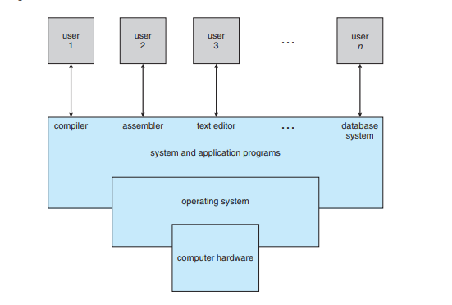
OBJECTIVES
• To describe the basic organization of computer systems.
• To provide a grand tour of the major components of operating systems.
• To give an overview of the many types of computing environments.
• To explore several open-source operating systems

Slide 10
FUNCTIONS
Convenience: An OS makes a computer more convenient to use.
• Efficiency: An OS allows the computer system resources to be used in an efficient manner.
• Ability to evolve: An OS should be constructed in such a way as to permit the effective development, testing, and introduction of new system functions without interfering with service

Slide 11
EVOLUTION
Serial Processing :
With the earliest computers, from the late 1940s to the mid-1950s, the programmer interacted directly with the computer hardware; there was no OS. These computers were run from a console consisting of display lights, toggle switches, some form of input device, and a printer. Programs in machine code were loaded via the input device (e.g., a card reader). If an error halted the program, the error condition was indicated by the lights. If the program proceeded to a normal completion, the output appeared on the printer. These early systems presented two main problems:
A) Scheduling:
Most installations used a hardcopy sign-up sheet to reserve computer time. Typically, a user could sign up for a block of time in multiples of a half hour or so. A user might sign up for an hour and finish in 45 minutes; this would result in wasted computer processing time. On the other hand, the user might run into problems, not finish in the allotted time, and be forced to stop before resolving the problem.
B) Setup time:
A single program, called a job , could involve loading the compiler plus the high-level language program (source program) into memory, saving the compiled program (object program) and then loading and linking together the object program and common functions. Each of these steps could

Slide 12
Simple Batch Systems
Early computers were very expensive, and therefore it was important to maximize processor utilization. The wasted time due to scheduling and setup time was unacceptable. To improve utilization, the concept of a batch OS was developed. It appears that the first batch OS (and the first OS of any kind) was developed in the mid-1950s by General Motors for use on an IBM 701 [WEIZ81].
The concept was subsequently refined and implemented on the IBM 704 by a number of IBM customers. By the early 1960s, a number of vendors had developed batch operating systems for their computer systems. IBSYS, the IBM OS for the 7090/7094 computers, is particularly notable because of its widespread influence on other systems. The central idea behind the simple batch-processing scheme is the use of a piece of software known as the monitor .
With this type of OS, the user no longer has direct access to the processor. Instead, the user submits the job on cards or tape to a computer operator, who batches the jobs together sequentially and places the entire batch on an input device, for use by the monitor. Each program is constructed to branch back to the monitor when it completes processing, at which point the monitor automatically begins loading the next program

Slide 13
Operating System Structures
1- layered
2- Monolithic
3- Microkernel

Slide 14
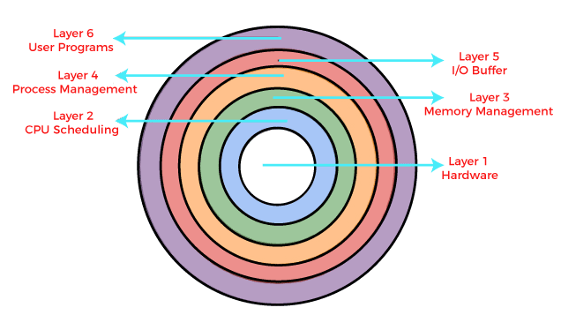
Layered Structure is a type of system structure in which the different services of the operating system are split into various layers, where each layer has a specific well-defined task to perform

Slide 15
Advantages :
Modularity :- This design promotes modularity as each layer performs only the tasks it is scheduled to perform.
Easy debugging :- As the layers are discrete so it is very easy to debug. Suppose an error occurs in the CPU scheduling layer, so the developer can only search that particular layer to debug, unlike the Monolithic system in which all the services are present together.
Easy update : -A modification made in a particular layer will not affect the other layers.
No direct access to hardware :- The hardware layer is the innermost layer present in the design. So a user can use the services of hardware but cannot directly modify or access it, unlike the Simple system in which the user had direct access to the hardware.
Abstraction :-Every layer is concerned with its own functions. So the functions and implementations of the other layers are abstract to it.

Slide 16
Disadvantages :
Though this system has several advantages over the Monolithic and Simple design, there are also some disadvantages as follows.
Complex and careful implementation :-As a layer can access the services of the layers below it, so the arrangement of the layers must be done carefully. For example, the backing storage layer uses the services of the memory management layer. So it must be kept below the memory management layer. Thus with great modularity comes complex implementation.
Slower in execution :-If a layer wants to interact with another layer, it sends a request that has to travel through all the layers present in between the two interacting layers. Thus it increases response time, unlike the Monolithic system which is faster than this. Thus an increase in the number of layers may lead to a very inefficient design.

Slide 17
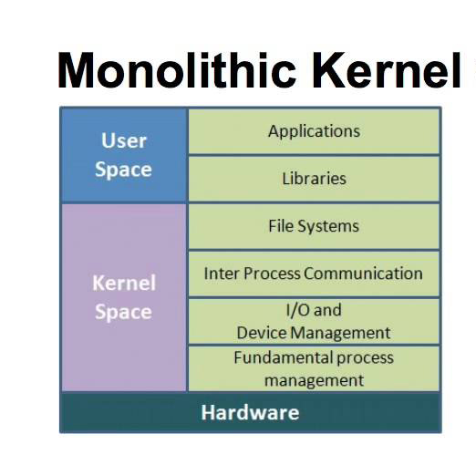
A monolithic kernel is an operating system architecture where the entire operating system is working in kernel space.

Slide 18
Advantages :
The execution of the monolithic kernel is quite fast as the services such as memory management, file management, process scheduling, etc., are implemented under the same address space.
A process runs completely in single address space in the monolithic kernel.
The monolithic kernel is a static single binary file.
Disadvantages :
If any service fails in the monolithic kernel, it leads to the failure of the entire system.
The entire operating system needs to be modified by the user to add any new service.

Slide 19
Features of Monolithic System
The monolithic operating system provides the following features to the users, such as:
Simple structure: This type of operating system has a simple structure. All the components needed for processing are embedded into the kernel.
Works for smaller tasks: It works better for performing smaller tasks as it can handle limited resources.
Communication between components: All the components can directly communicate with each other and also with the kernel.
Fast operating system: The code to make a monolithic kernel is very fast and robust.

Slide 20
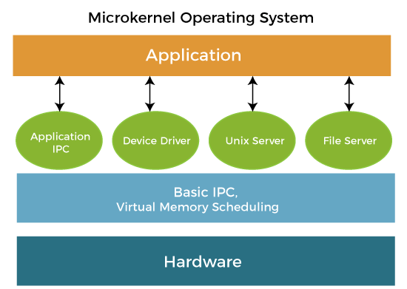
A microkernel is a kernel type that provides low-level address space management, thread management, and interprocess communication to implement an operating system.

Slide 21
Advantages :
The architecture of this kernel is small and isolated hence it can function better.
Expansion of the system is easier, it is simply added to the system application without disturbing the kernel.
Disadvantages :
In a microkernel system, providing services are more costly than in a traditional monolithic system.
The performance of a microkernel system might be indifferent and cause issues.

Slide 22
